Slide 1

Traffic Sign Classification
Phase - 2 Presentation

Slide 2
About the team
Guide
Mr. Ramesh Shettigar Assistant Professor Grade II
Members
Ankith Bhandary - 4NM17CS020
Dhruv Shetty - 4NM17CS057
Kishan - 4NM17CS090
Manukashyap U V - 4NM17CS101

Slide 3
Problem Statement
Creation of fast, lightweight and automatic system that is capable of real time detection, classification and interpretation of traffic signs.

Slide 4
Objectives
Train a deep learning model on an industry standard database of traffic signs.
Refine the model to detect traffic signs with large intra-category appearance variation.
Provide real time detection, classification and interpretation of the traffic signs.

Slide 5
Phase - 1 Progress
Literature Survey.
Data set acquisition.
Data pre-processing.
Image Augmentation

Slide 6
Phase - 2 Objective
Create a CNN model on the GTSRB data set.
Train the model.
Test the different variations of the model for high accuracy.

Slide 7
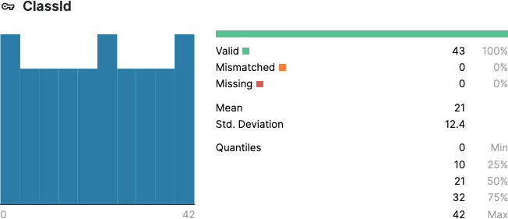
Data Set Values
All the mismatched and missing values are removed

Slide 8
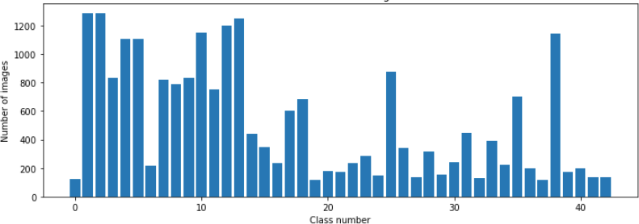
Data Set Values Distribution
34799 images distributed over 43 different classes.

Slide 9
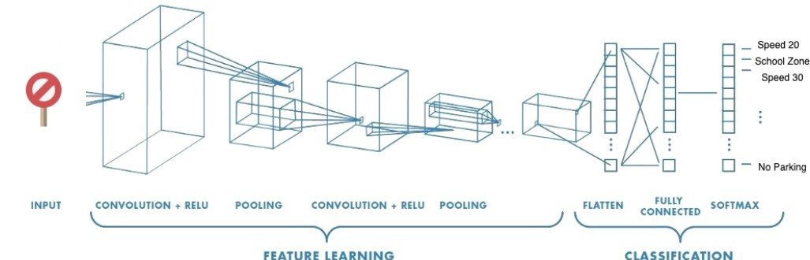
CNN model for TSC

Slide 10
CNN Model Info
Sequential Model
1st conv2d layer - 60 filters with 5x5 filter
2nd conv2d layer- 60 filters with 5x5 filter
3rd conv2d layer- 30 filters with 3x3 filter
4th conv2d layer- 30 filters with 3x3 filter
Maxpooling with 2x2 filter
Dropout of 0.5
Flatten
Dense layer with 500 nodes
Dropout of 0.5
Dense layer of 42 nodes with SoftMax activation.

Slide 11

Convolution operation on a MxNx3 image matrix with a 3x3x3 Kernel

Slide 12
Training the model
Most accurate model
Batch Size = 500
Steps per epoch = 400
Epochs = 50
Accuracy = 99%
Resource Used
• CPU = 2 Core of Intel Xeon
• GPU = Tesla P100 16GB VRAM
• RAM = 13GB
• SSD = 10GB

Slide 13
Accuracy Variation of Model Instances

Slide 14
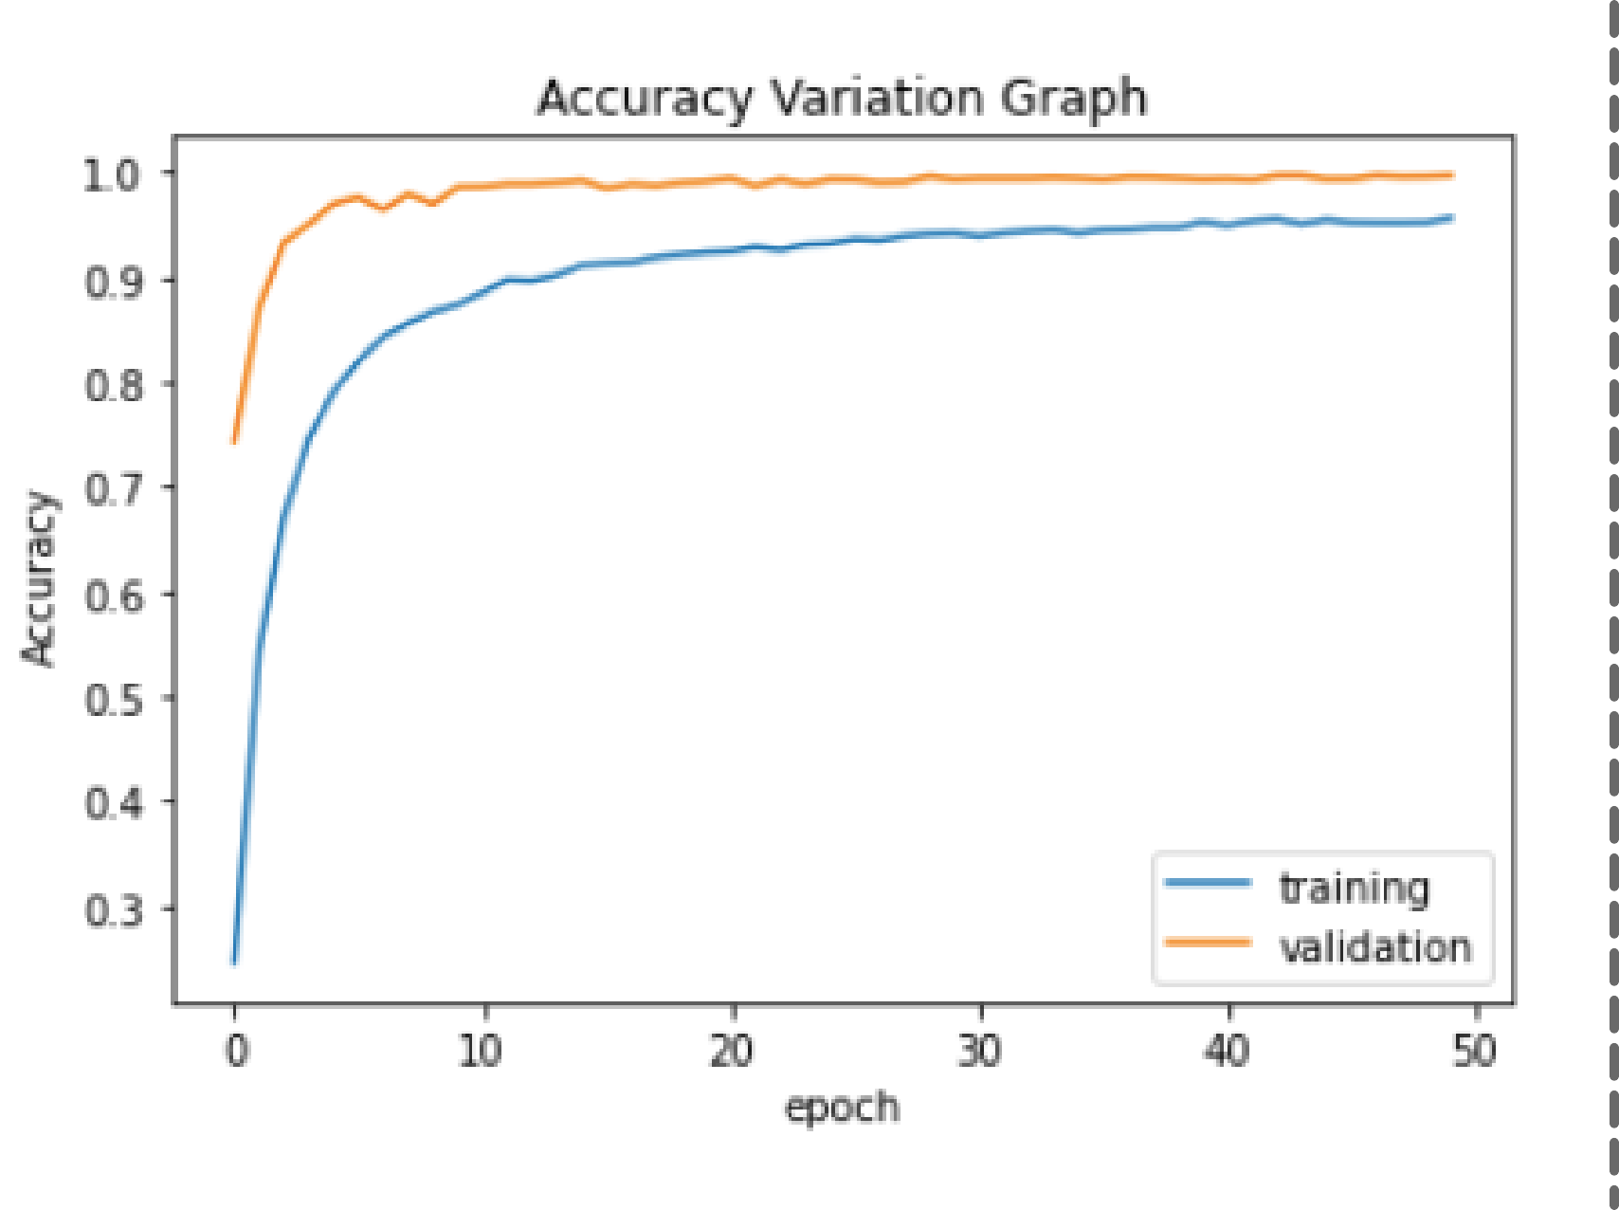
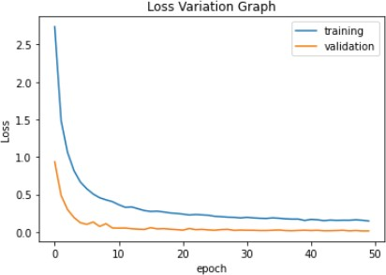
Loss and Accuracy Graph
The validation curve is above the training curve in accuracy variation graph, signifying that the model considered is not overfitting.
Loss variation graph helps show the decline in bad predictions as the epoch count increases, further solidifying the parameters used in model 5

Slide 15
Saving The Model
Serializing the model and weights to JSON and HDF5

Slide 16
Future Work
The designed model has achieved its theoretical accuracy. Next, we'll deploy its functionality through a camera interface. This will simulate the real life application of this model to a good extent.
On equipping a camera to read the sign and output the sign read, we now make efforts to acquire the result in real time similar to real life scenarios. This will help the automated vehicle make necessary decisions quickly.

Slide 17

Thank You

